Slide 1
Presentation on Article High-Cardinality Categorical Attributes and Credit Card Fraud Detection
Carneiro, E.M.; Fo rster, C.H.Q.; Mialaret, LF.S..; Dias, L.A. V.;da Cunha, A.M. Mathematics 2022, 10, 3808. https://doi.org/10.3390/math10203808

Slide 2
Article Overview:
This paper reports our findings on the positive impacts of using high-cardinality attributes on credit card fraud detection. Thus, we present a new algorithm for domain reduction that preserves the fraud-detection capabilities.
Applying a deep feed forward neural network on real datasets. when measured by the F-1 metric, the inclusion of such attributes does improve fraud-detection quality.
As a main contribution, this proposed algorithm was able to reduce attribute cardinality, improving the training times of a model while preserving its predictive capabilities.

Slide 3
General Discussion
Credit card issuers make use of fraud-detection systems.
Fraudsters constantly change their strategies in order to avoid detection. As a result, traditional rule-based fraud-detection systems turn obsolete very fast
This motivates research on the applicability of Machine Learning (ML) techniques to this problem.

Slide 4
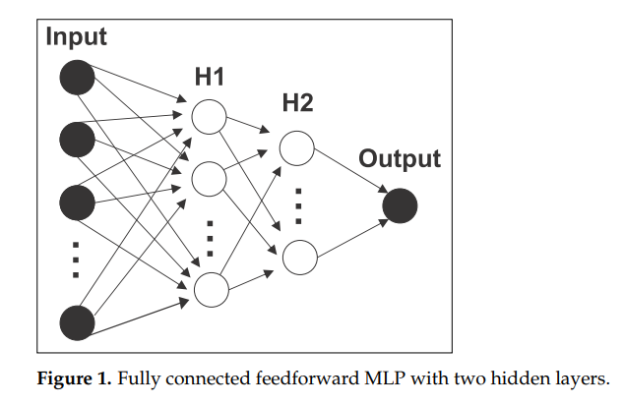

Materials and Methods 1)Value Clustering for Categorical Attributes (VCCA) Algorithm 2) Deep Feed Forward Networks (FFN), also known as Multi Layer Perceptron (MLP)
One input layer
Two hidden layers (H1 and H2)
One output layer
Attributes from a credit card transaction were fed to the input layer and processed by the hidden layers, resulting in a unique output containing a fraud score, where values higher than a threshold were translated as fraudulent transactions.
The Rectified Linear Activation Function (ReLU) [45], presented in Equation (1), was used as an activation function for the hidden layers. The sigmoid function, presented in Equation (2), was used on the output neuron.

Slide 5
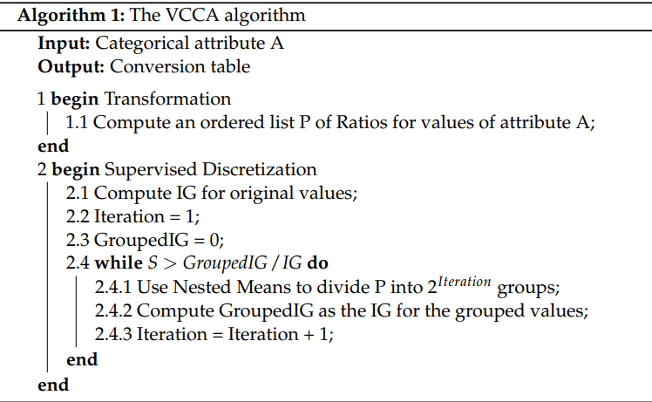
VCCA Algorithm : Clustering for Categorical Attributes (VCCA) Supervised algorithm designed for decision problems Consists of two steps: transformation and supervised discretization Recommended to use only a portion of the dataset to generate the conversion table, to avoid overfitting. The end result of the algorithm is a conversion table that associates values with groups.

Slide 6
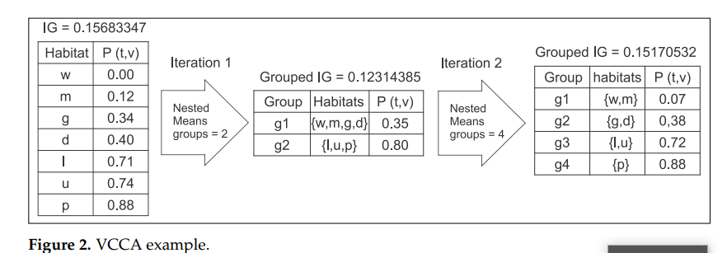
Output of VCCA Algorithm

Slide 7
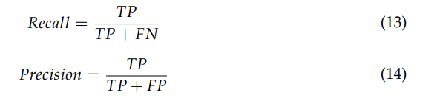

F-1 Metrics Requirement for a fraud-detection system Identify most of the fraudulent transactions, Generate as few false alerts as possible.
The first requirement could be measured through the Recall, also known as True Positive Rate (TPR) metric
The second one could be measured by the Precision metric
The third metric, F-1, which is the harmonic mean of Recall and Precision.

Slide 8
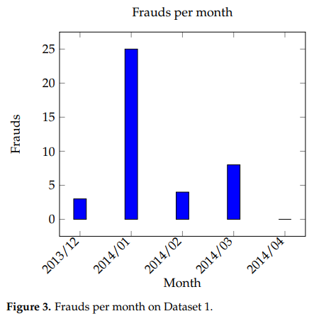
Data Set description Data Set Training:
Data date duration : December 2013 to April 2014.
Total Records: 11829
Number of fraudulent : 40
Percentage of fraudulent : 0.34%.

Slide 9
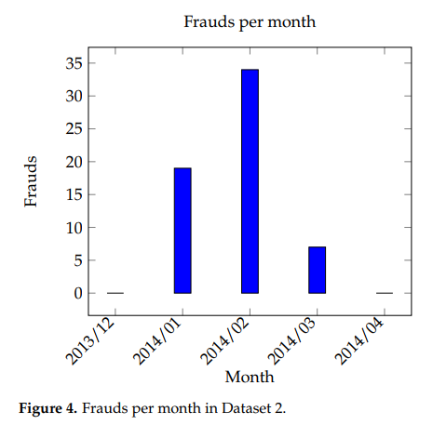
Data Set description Data Set Test:
Data date duration : December 2013 to April 2014.
Total Records: 27569
Number of fraudulent : 51
Percentage of fraudulent : 0.18%.

Slide 10
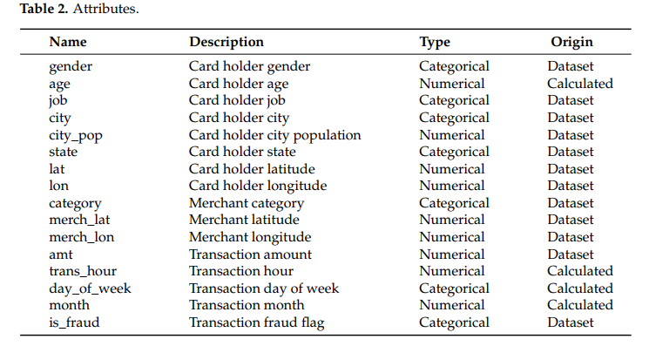
Data Set Sample Attributes:

Slide 11
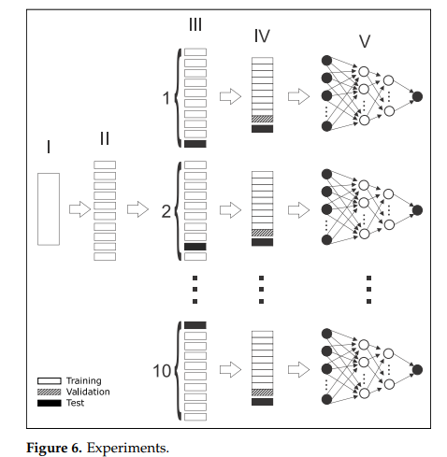
Experiments
Used stratified 10-fold cross validation on each dataset
10 different sets of training and test datasets are generated
Sampling is used to generate a validation dataset
The training and the validation datasets are used by the VCCA algorithm to generate the conversion table
The training and the validation dataset are then used to train the FFN (V) and the resulting model is evaluated on the test dataset.
Training and evaluation are executed 100 times for each dataset.

Slide 12
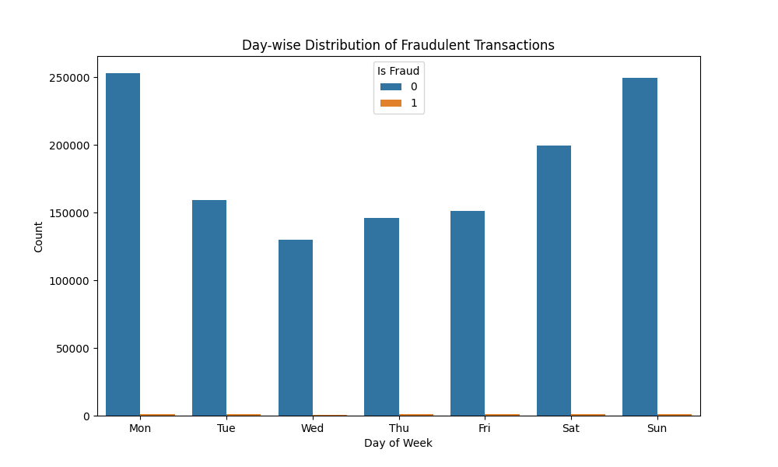
Day-wise distribution of Fraudulent Transaction

Slide 13
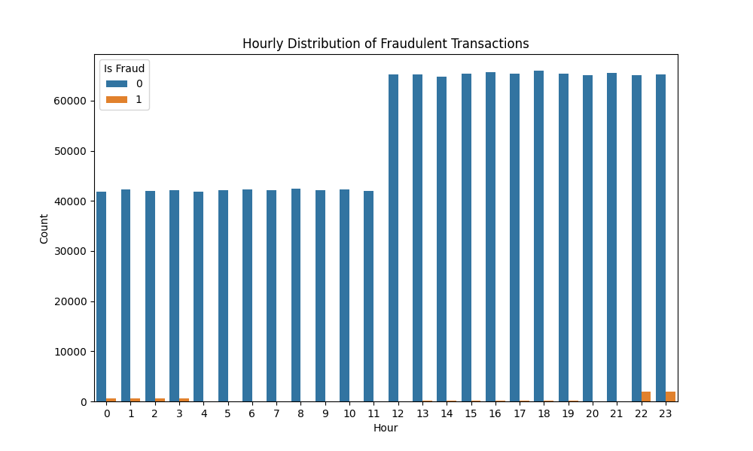
Hourly Distribution of fraudulent Transaction

Slide 14
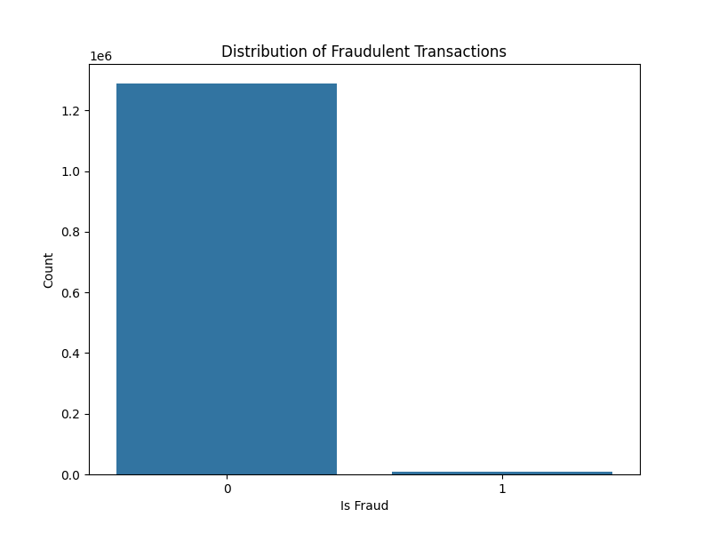
553574 Legal transacción 2145 Fraud transacción

Slide 15

Activity at Python to analyze data set

Slide 16
Accuracy of various algorithm from test data validation.
Logistic Regression Accuracy: 81.827%
SVM Accuracy: 85.982%
KNN Accuracy: 87.922%
Random Forest Accuracy: 97.482%
MLP Accuracy: 95.766%
SGD Accuracy: 85.090%
Extra Tree Accuracy: 97.209%

Slide 17
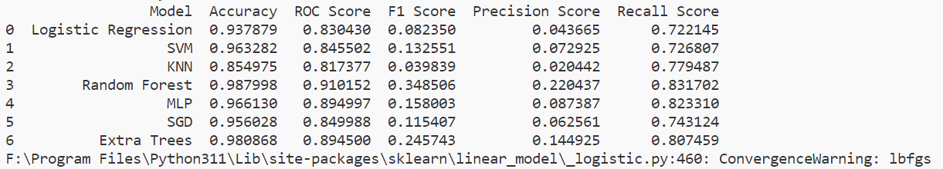
Comparison of various algorithm

Slide 18
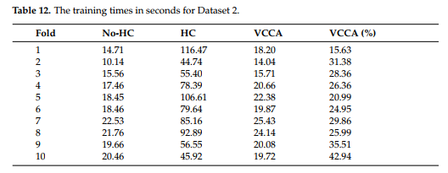
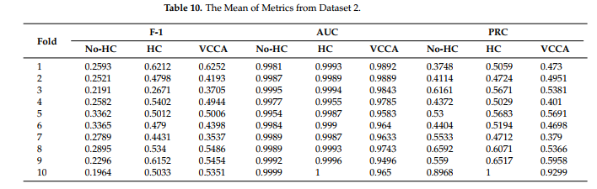
Summary
Trained Feed Forward Network in three scenarios
without HC attributes
including HC attributes
including HC attributes transformed using Value Clustering for Categorical Attributes (VCCA).

Slide 19
Results
HC attributes can improve detection quality, measured by F-1, in credit card fraud detection.
Value Clustering for Categorical Attributes shown promising results by
allowing the inclusion of HC attributes
reduced training times significantly
Maintain better detection quality
Reduce costs

